Slide 1
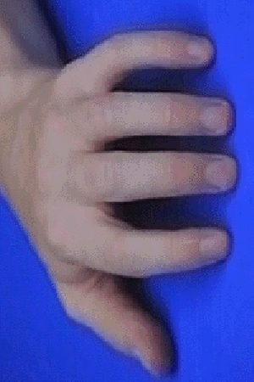
Instructions - Exp
In this task you will see a photo of a hand on the screen. The photo will be rotated like the one in this picture.
You need to keep your index finger pressing down on the ‘V’ and your middle finger on the ‘B’ keys on the keyboard.

Slide 2
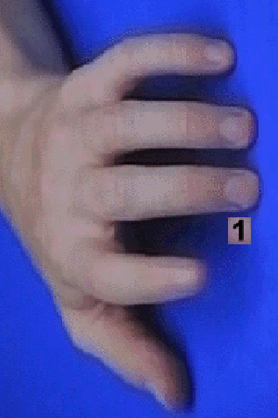
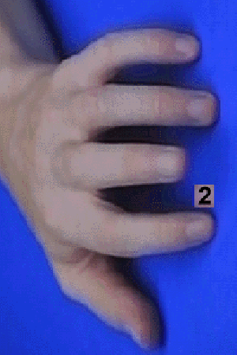
When you see a number appear between two of the fingers of the hand this is a signal for you to make a finger movement.
If you see a 1 you must always move your index finger
If you see a 2 you must always move your middle finger

Slide 3

After your have made the finger movement a blue screen will appear for a short period of time before the hand photo appears again.

Slide 4
Just before you start this task you will get a practice session so that you can get used to making this type of response.
The practice will keep going until you get 10 correct finger movements in a go, so be careful and try not to lift up the wrong finger!
A few times during the task you will be asked to take a break.
When you are ready to start again, press the space bar and put your index and middle finger back into position (pressing down on the V and B keys).
Please try to respond as quickly and as accurately as possible!

